Slide 2


Slide 3
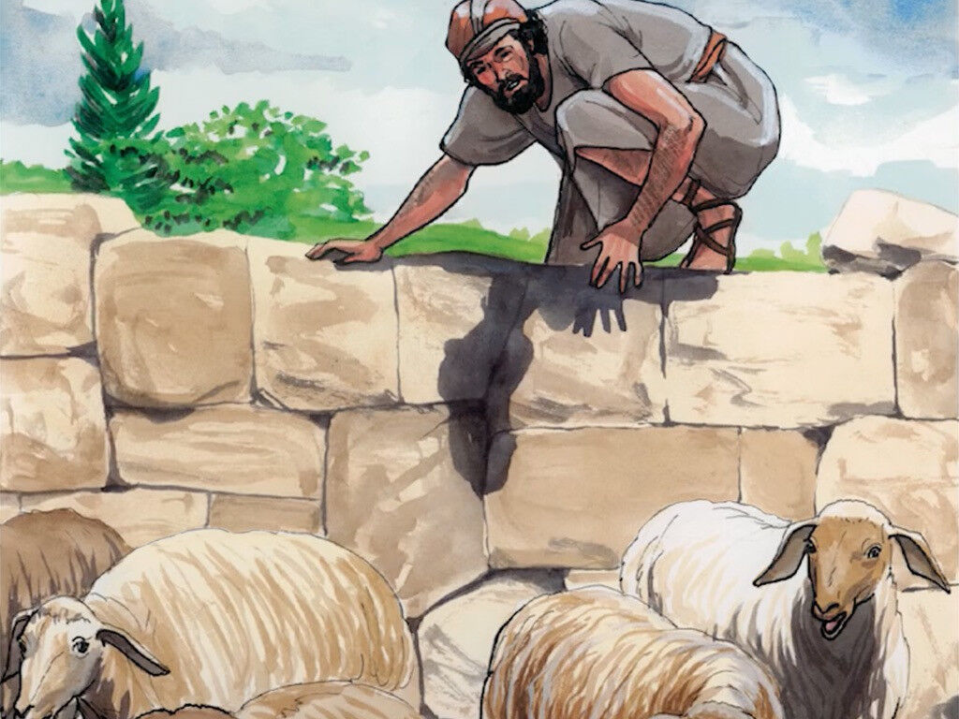
SUPERIORITY OF JESUS OVER FALSE CHRISTS
John 10:1-18
JESUS AS THE SHEPHERD OF THE SHEEP
Jeremiah 23:1 – “scatter the sheep”
Jeremiah 10:21 – “flocks shall be scattered”
Jeremiah 23:4 – Prophesied Messiah
John 6:66 – “many of His disciples went back and walked with Him no more”

Slide 4
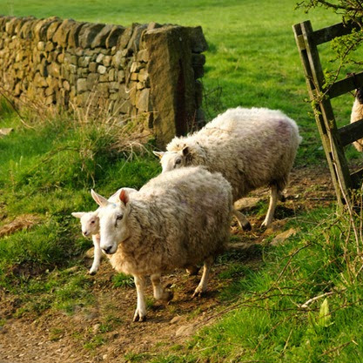
SUPERIORITY OF JESUS OVER FALSE CHRISTS
John 10:3
THEY KNOW THE VOICE OF THEIR SHEPHERD
“I Am the Messiah” – John 4:25,26
Commitment was necessary – began to leave – John 6:66
Suffered persecution from Jews- John 9:22

Slide 5
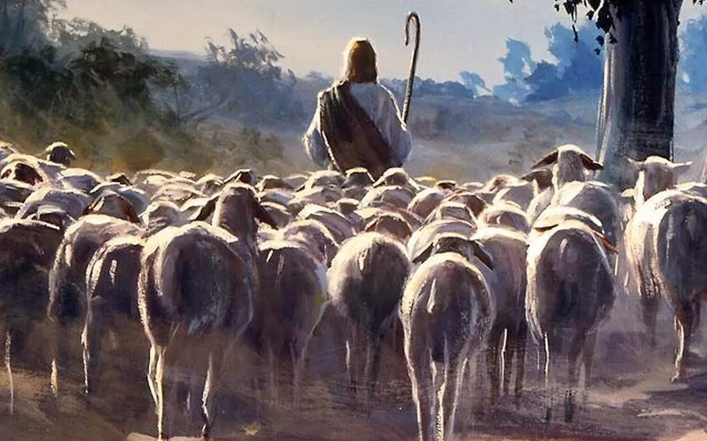
SUPERIORITY OF JESUS OVER FALSE CHRISTS
John 10:5
THEY FLEE FROM STRANGERS
“in no way follow”
Strange Doctrines – to mislead the sheep
Hebrews 5:14 – “have their senses exercised to discern good and evil”
Acts 5:35-39 - Gamaliel

Slide 6
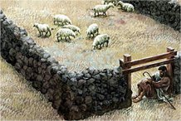
JESUS AS THE DOOR
John 10:7-10
Jesus the Entrance to Kingdom – John 14:1-6
Door Used As Well To Protect – keep what’s Inside, INSIDE – Outside, OUTSIDE

Slide 7
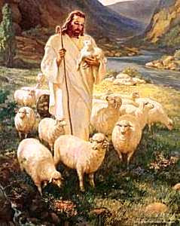
JESUS AS THE GOOD SHEPHERD
John 10:11-18
John 16:13 – the Good Shepherd lays down His life for the sheep
1 Corinthians 6:20 – bought at a price
1 Peter 1:18,19

Slide 8
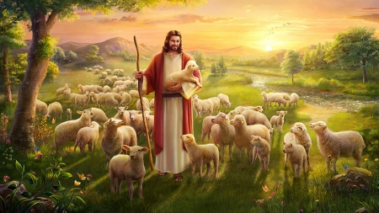
JESUS HAS OTHER SHEEP NOT OF THIS FOLD
John 10:16
What FOLD?
Matthew 15:24 “house of Israel”
What OTHER sheep were there?
Gentiles – 1 Corinthians 12:13
Ephesians 2:11-16

Slide 9
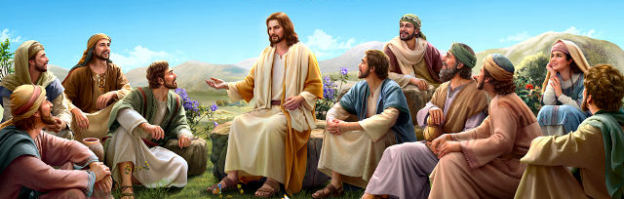
EACH PARABLE CENTERED ON RELATIONSHIP OF A SHEPHERD AND HIS SHEEP
HEAR HIS WORDS!
John 12:47-49

